Slide 1

David Claimant Tagline: “I want to claim money back quickly & easily” | Goals: To get work expenses refunded into his bank account as soon as possible to avoid interest charges on his credit card To be able to claim expenses on his tablet/phone/laptop whilst on the move For the system to be quick & simple to use as he has a very busy schedule | Frustrations & pain points: Doesn’t use the system very often so finds it difficult to remember how to use it Trying to work out which finance codes to use Having to remember yet another password Not being able to access the system whilst out & about
Background David has worked for the University for 10 years as a lecturer and researcher. He’s an expert in his field and this work regularly takes him to conferences and other research centres. He often has time in airports or on the train when he likes to catch up on admin tasks via his tablet, phone or laptop. | How does David use MyExpenses? Submits expense claims for approval Views the status of his claims Prints claims off for sending to Finance

Slide 2

Mike Approver Tagline: “This statement sums me up, pretty much” | Goals: To get his staff’s expense claims approved as soon as possible | Frustrations & pain points: List the key frustrations
Background Mike is David’s line manager and is the head of the department. | How does Name use MyExpenses? Approving/rejecting claims Returning claims to claimants for additional information

Slide 3
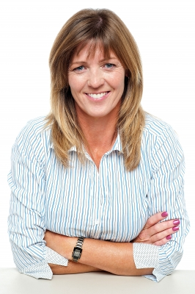
Lorraine Budget Holder Tagline: “This statement sums me up, pretty much” | Goals: List the key goals | Frustrations & pain points: List the key frustrations
Background Jane is . . . . She’s responsible for managing the budget for her area and needs to know what will be charges to expect. | How does Name use MyExpenses? Viewing claims made against their budget

Slide 4

Claire Proxy-Claimant Tagline: “This statement sums me up, pretty much” | Goals: List the key goals | Frustrations & pain points: Can’t add new cost centres for their proxy
Background Claire is a departmental administrator and sometime has to make expense claims on behalf of her manager. | How does Name use MyExpenses? Submitting claims on someone else’s behalf Viewing the status of claims Printing claims

Slide 5
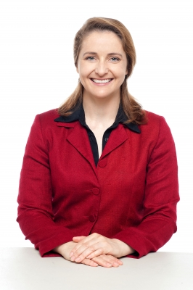
Jane Accounts Payable Tagline: “This statement sums me up, pretty much” | Goals: List the key goals | Frustrations & pain points: List the key frustrations
Background A couple of lines to add some flavour. | How does Name use MyExpenses? Sample audit check

Slide 6

Dave FIS Support Tagline: “Take away the mundane stuff so that I can concentrate on value-added tasks” | Goals: For the data to flow into eFin with no manual input other than by exception For users to have the same password as for EASE so that they remember them | Frustrations & pain points: Running a manual interface everyday Re-setting passwords as they’re different to EASE so users forget them and lock themselves out of the system Setting up new cost centres even though they already exist in eFin
Background A couple of lines to add some flavour. | How does Dave use MyExpenses? Setting up new users Running reports against the data

