Slide 1
Overleaf
Business Case
November 2018

Slide 2
Overleaf Business Case
Executive Summary
LaTeX is a high-quality typesetting system; it includes features designed for the production of technical and scientific documentation. LaTeX is the de facto standard for the communication and publication of scientific documents and is used currently by the University as a stand alone tool for users.
ShareLaTeX and Overleaf are online LaTeX editors that allow real-time collaboration and online compiling of projects to PDF format.
Currently there are a number of users across the College for OverLeaf and ShareLaTex, primarily of their free services and it has been raised as to whether the university could get a license for OverLeaf. Initial investigations have also shown that many of the high end competitors of the University (Imperial, Cambridge) have site licenses for OverLeaf or ShareLaTex which they offer to both academics and students.
The Senior User of the project has completed a one year OverLeaf pilot which started in January 2018. The aim of the pilot was demonstrate that there is enough demand for the product in other schools across the University and to satisfy that the additional functionality offered through a site wide licence was a worthwhile investment. That criteria has been fully met and is evidenced in Appendix I within the business case metrics.
The site wide licence is a subscription service that provides Overleaf Professional accounts for students, faculty and staff throughout the University. The service provides a collaboration environment with streamlined branded enrolment, a resource portal with featured templates, member training and administrative analytics and metrics. The University also benefits from an easy submission portal for the online repository.
Need For Change
There are significant drivers for change to justify the move to the site wide licencing model including strategic fit, technology, operational, quality and competition. Further details of these can be found in Appendix II

Slide 3
Overleaf Business Case
Benefits
Overleaf Commons is the subscription service for institutions to provide Overleaf Professional accounts to students, faculty and staff throughout their university. This service provides streamlined, branded enrolment, a resource portal with featured templates, member training and administrative analytics/metrics.
Cost
Collaboration
Consistent standard and formatting
Heavy duty mathematics syntax type supported including back level support (not available in MS Word)
Multi-lingual support for ancient and modern characters and fonts
Supports broader use including Music, ancient languages and literatures
Group Account - A set number of Overleaf Collaborator or Professional accounts for members and staff. Group accounts include a team management dashboard to add and remove team members. Centralised billing and admin with the option to reassign licenses as needed.

Slide 4
Overleaf Business Case
Risks
Usage drops below financially viable levels
Service not well communicated or understood
Non-compliance risk through Cloud security and IT governance
Schools discontinue using the application having committed to three year agreement
Funding Model: not all subjects will be willing to meet their proportional commitment to a purchase

Slide 5
Overleaf Business Case
Success Criteria
A one year pilot of Overleaf was conducted which included marketing and communications for encouraging user participation across additional schools in the University.
Success criteria factors were defined and measured to demonstrate that there was positive quantitative indicators for the justification that would support the business case to acquire an appropriate licence model for the University.
These success criteria included; number of additional licences allocated, number of active users increasing, number of new projects started, increasing levels of collaboration and additional schools uptake.
Across all these indicators there has been a twofold increase across the board and usage is continuing to grow month on month. October 2017 to November 2018
Details of this can be found in Appendix III.
Funding Options
Option 1 – Purchase Overleaf site wide license funded by University
Option 2 – Purchase Overleaf license for CSCE funded by College
Option 3 – Purchase Overleaf license for School of Engineering funded by school
Option 4 – Purchase Overleaf license for consortium of schools and split costs
Recommended Funding Option:
The recommended funding option is … This is based on …?
See Appendix III for the investment profile.

Slide 6
Overleaf Business Case
Costs
Option 1 – University-Wide.
All students, faculty & staff
 |  | Year 1 | Year 2 | Year 3
Overleaf Commons (List Price) |  | £19200 | £19200 | £19200
30 Day Signing Discount | -15% | -£2880 | -£2880 | -£2880
3-yr Contract Discount | -10% | -£1632 | -£1632 | -£1632
Year 1 Roll-out Discount | -20% | -£2938 | N/A | N/A
Total |  | £11750 | £14688 | £14688
3-yr Total |  |  |  | £41126
No of Users | Cost per user per Year
1260 Yr 1 | £9.35
1260 Yr 2 + 3 | £11.71
 |  | Year 1 | Year 2 | Year 3
Overleaf Commons (List Price) |  | £12700 | £12700 | £12700
30 Day Signing Discount | -15% | -£1905 | -£1905 | -£1905
3-yr Contract Discount | -10% | -£1080 | -£1080 | -£1080
Year 1 Roll-out Discount | -20% | -£1943 | N/A | N/A
Total |  | £7772 | £9716 | £9716
3-yr Total |  |  |  | £27203
Option 2 – College-Wide.
CSE students, faculty & staff

Slide 7
Overleaf Business Case
Recommendation
To purchase a site wide three year licence agreement funded by the University.

Slide 8
Overleaf Business Case
Appendix I
Drivers For Change

Slide 9
Overleaf Business Case
Driver for Change– Strategic Fit
This project aligns with the overall University of Edinburgh Mission Statement:
“We deliver impact for society. We discover, develop and share knowledge.”
Contributes to the aims of:
“provide the highest-quality research-led teaching and learning”
And meets the following ‘Leadership in Research’ objectives:
“progressively increase collaborative academic research and innovation outputs of the highest quality and value”
“invest in digital services that are key to discovery, development and sharing”

Slide 10
Overleaf Business Case
Driver for Change– Technology
A number of solutions in document preparation that are important not only in research but also in learning and teaching have recently been moved to a “cloud” based provision.
Related technologies have been greatly improved in speed and efficiency, underpinned by the strengthening and proliferation of internet connectivity in and out of the work place
There is now an expectation that all documents can be easily shared and collaborated on and this includes scientific writing
Following and capitalising on this trend a cloud based LaTex authoring solution is rather timely and a useful advancement towards gaining efficiency in its use by researchers, educators and students.
Developments in cloud technology now means that the whole scientific writing process can be brought into one connected place - from idea, to writing, to review, to publication

Slide 11
Overleaf Business Case
Driver for Change– Operational
Collaboration in research is key for success and up to now the process of collaboration in preparing the final dissemination outputs with LaTeX was not simple
Overleaf allows for effective collaboration in LaTex based documents (papers, reports, etc.) and brings great efficiencies in the process, saving a great amount of time and effort in reviewing and finalising outputs
Introducing such a solution provides efficiencies in collaboration for research dissemination, theses and report generation (taught MSc, final year projects, PhD theses)
Such a tool has the capacity to streamline the reviewing and support of PhD and MSc students when writing their theses and reports
Supervisors and other research collaborators could be easily involved in concurrent reviewing shortening the cycle of review and final document preparation and submission significantly
Importantly, it would also allow for seamless collaboration with researchers within but crucially from outside the University

Slide 12
Overleaf Business Case
Driver for Change– Quality
There is potential in more widely adoption in teaching and specifically in exam preparation where LaTeX can be used more consistently to avoid issues in papers containing significant mathematical and technical content where often work processing based solutions can potentially create problems (e.g. consistency in treating mathematical symbols
A cloud based solution for LaTex, as provided by Overleaf, does not fix a specific problem as one can still use traditional methods of emailing PDFs for commenting and editing but it introduces significant efficiencies by eliminating this laborious and error prone process.
A simple comparison could be made with the similar ability and efficiency in using standard word processing flows for tracking edits, changes and comments in word processing based documents (e.g. Word). Similarly, having a master copy of your work always backed up in the cloud minimises the risk of erasing important work by mistake

Slide 13








Overleaf Business Case
Driver for Change– Competition
A good number of our comparator Universities already support such a solution and Edinburgh University should be amongst those institutions.

Slide 14
Overleaf Business Case
Appendix II
Success Criteria & Trial Metrics

Slide 15
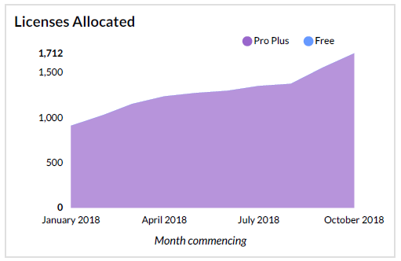
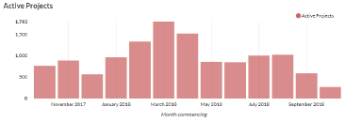
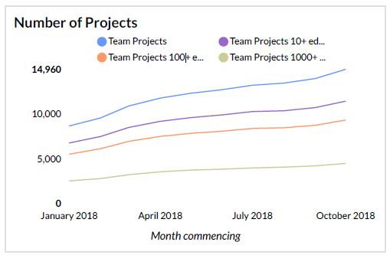
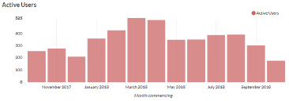
Overleaf Business Case
Pilot Metrics
October 2017 to October 2018
by Month
This represents a twofold increase in all aspects over the same period in 2017

Slide 16
Overleaf Business Case
Schools Analysis

