Slide 1
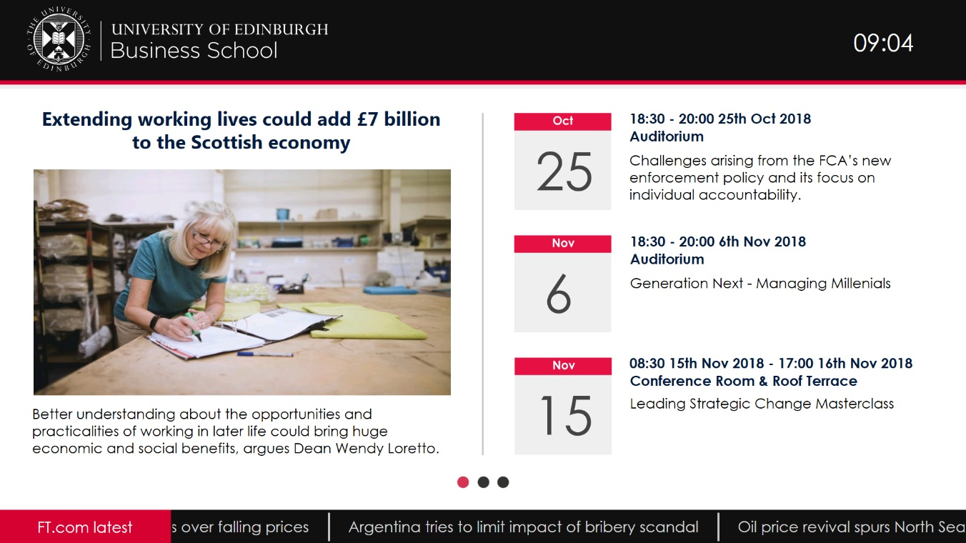
Digital Signage
Large Screen – Reception Areas / Welcome

